Slide 1
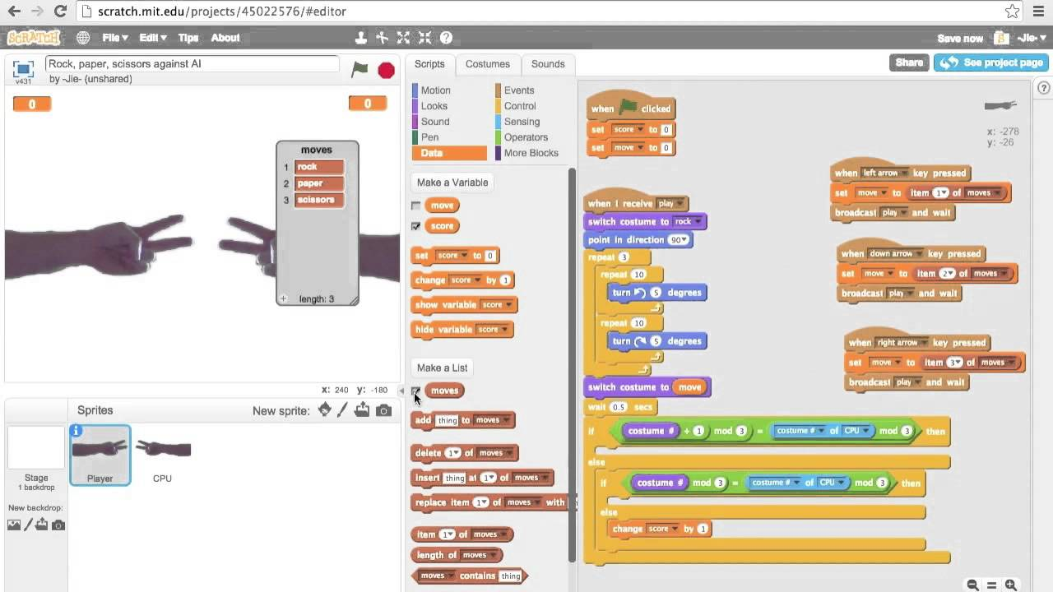
Rock Paper Scissors Liana & Victoria
What we want to accomplish with our code is to be an interactive game where the players play against the computer

